Slide 1
Team Victor – Silent Music Party – Android Application
Silent Music Party
TEAM NAME : VICTOR
Anusha Ravichandran(2521040)
Krishnendhu Rajappan(2562559)
Meghana Shanthi Pamula(2623058)
Ranjani Krishnan(2691637)
Sowmya Ravikumar(2532453)
Varsha Dubey(2344052)

Slide 2
Table of Contents
1……..Introduction 3
1.1 Purpose 3
2……..Design Overview 4
2.1 Introduction 4
2.2 Roles and Entities 5
2.3 Use case diagram 7
3……..Architecture 8
3.1 Description of technical architecture 9
3.2 Interactive UI
3.3 Ad hoc network
3.4 Socket programming
4…….Implementation 10
5…….Conclusion 11

Slide 3
1. Introduction:
Without music, a party can be rather boring. Unfortunately, a lot of times the noise level of music can be a nuisance and kill a party faster than it started. Our application, Silent Music Party is the pinnacle of silent music service, providing state-of-the-art technology in the palm of the hand.
Music is still one of the key threads that bind us as humans, and our goal was to create an app that will be intuitive and fun to use. This app aids in synchronizing music across multiple devices over the cellular network. We took all the elements that make a silent music party interactive and distilled it into simple, easy functions in an app that makes a great time.
Through this design document, we will provide narrative view of silent music party. It includes technical description and demonstration of functionality through the snapshots.
1.1 PURPOSE
The silent music player is a concert that attempts to eliminate noise pollution by transmitting the sound to the listeners ears via headphones rather than traditional ambient methods. The elimination of noise pollution is beneficial for nearby campers, nearby residents, and is a good way to keep the music going late into the night when excess noise is traditionally unwelcome.

Slide 4
2. Design Overview
2.1 INTRODUCTION
Silent music party provide functionality of Synchronized listing of the music,
Shared stored playlist ,Voting for the song ( applicable only for dancing
people) and transferring of messages . The system revolves around two types
of users:
Organizer and Party member where each user is capable of performing
limited tasks which are relevant to their roles.

Slide 5
2.2 Roles and entities Below are the tasks lists for each role
Entities
user roles (organizer, party people)
party event
Role: User
create a party event
search for party events
join a party event
leave a party event
see other party members
group chat or individual chat
Role: organizer
Kick out party members
close the party event

Slide 6
Play song
Change song priority based on the voting by party members.
Role: party member
Having a locally stored and synchronized playlist enables synchronization in listing the current played song
adding songs to the playlist
voting songs on the playlist up/down (if I “dance”)
chat
leave the party.
2.3 USE DIAGRAM
We have described the roles of the application in the next slide using use diagram

Slide 7


Create Party
Join Party
Organizer
Kick out member
Party Event
Leave Party
Chat
Voting
Share Song
Song Change Priority
Party Member
Play Song

Slide 8
3. ARCHITECTURE:
USER INTERFACE
CLIENT
HOST
Main Activity
MESSAGE STREAM
Lobby
Party Container
SONG TRANSFERRING STREAM
Pager Adapter
ADHOC
Playlist
General Chat
Info
Private Chat

Slide 9
3.1 DESCRIPTION OF TECHNICAL ARCHITECTURE
The framework provides detailed description about the functioning and technical features of the application. It mainly combines multiple wireless hosts forming a temporary network without the assistance of any centralized services. We designed a flexible framework for UI design that allows the app to be more interactive. Our user interface primarily focuses on the requirements of the target user.
3.2 Interactive UI:
Interactive UI involves main activity which contains two main parts namely lobby and Party container. In lobby, users can view different other parties and in party container, we have a playlist, general chat, info and private chat features.
3.3 Ad hoc network:
Mobile ad-hoc networks will use mobile routers to provide Internet connectivity to mobile ad-hoc users. Ad-hoc networks are suited for use in situations where an infrastructure is unavailable or to deploy one is not cost effective. In our application we are creating a ad hoc network via wifi-direct to allow party member for joining the party, share synchronized songs etc.
3.4 Socket programming: We used java sockets to enable communication mechanism between the peers for message transferring and song synchronization feature we applied socket programming

Slide 10
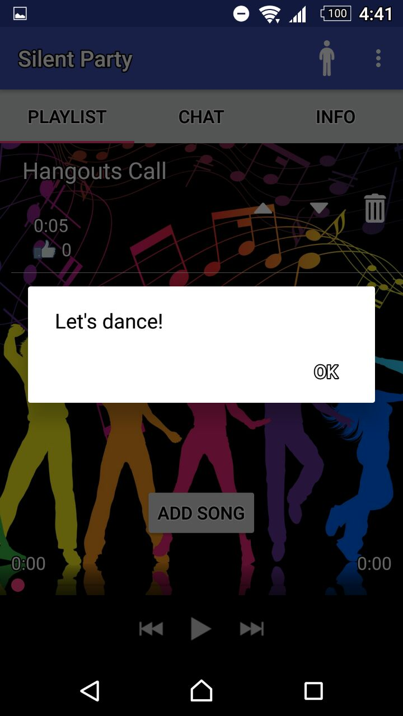
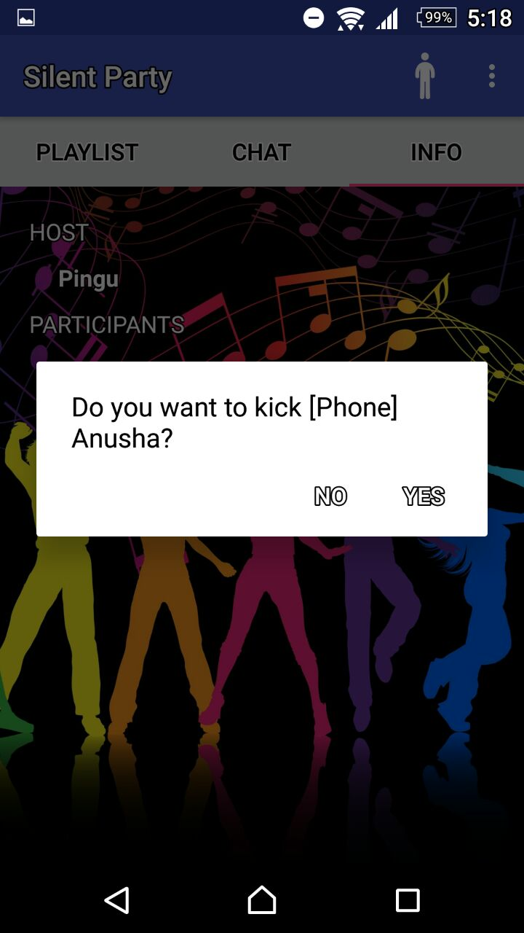
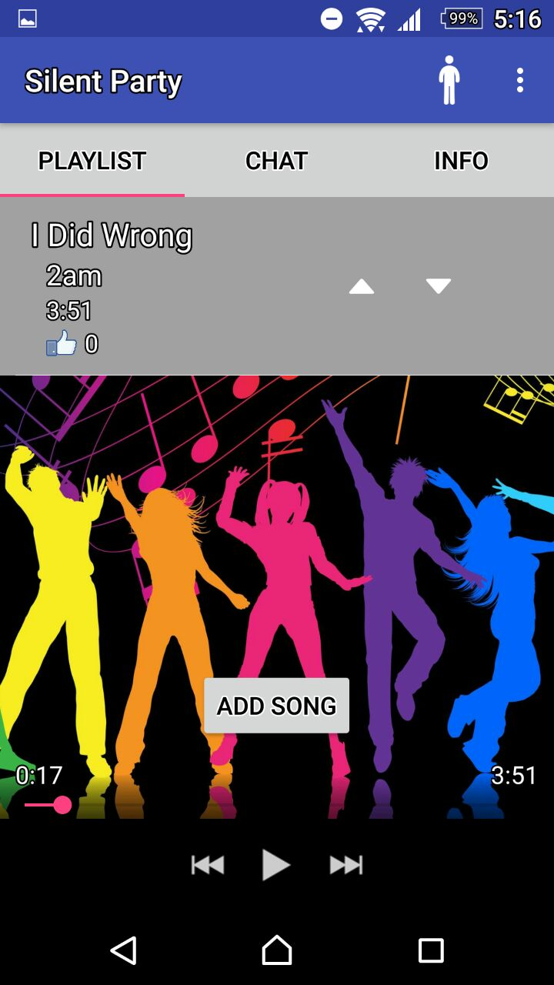
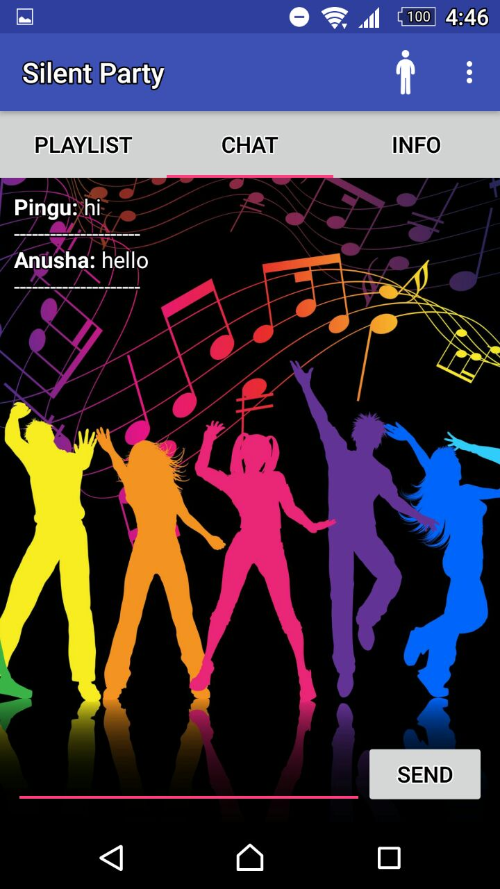
4. Implementation implemented the APK on android mobile and we extracted the snapshots to describe the functions of the application.

Slide 11
5. CONCLUSION
As a team, we worked on developing silent music party application which lead to the achievement of goals defined in the project feature list. This application minimises the noise caused in the party place and provides us with the environmental benefits. It enables users to make use of the developed application in an intuitive way. We, conclude by saying that this approach is Noiseless and user friendly.

